Slide 1

Assessing the feasibility and acceptability of smart EMA in young adults with a rare neurogenetic disease.
A Double Diamond Approach.
Kate Fifield (PhD Student)
Notes:
Hi, everyone. My name is Kate, and I am going to be talking to you today about how I engaged young adults with a rare neurogenetic disease in smartphone research that aims to provide better support for their everyday experiences.

Slide 2

How did you feel last Tuesday?
Notes:
If I asked this question to everyone in the room I would probably get this answer

Slide 3
How did you feel last Tuesday?
Fine
Notes:
The dreaded response for any parent or psychologist
But there is a solution

Slide 4



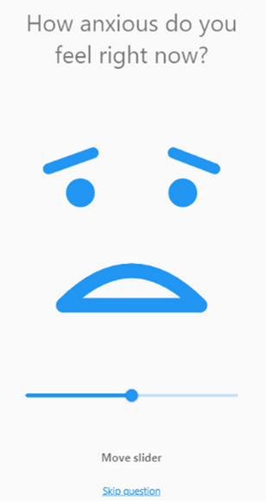
SMARTPHONE ECOLOGICAL MOMENTARY ASSESSMENT
(SMART EMA)
TUESDAY
WEDNESDAY
THURSDAY
FRIDAY
6.00 12.00 18.00 24.00 6.00 12.00 18.00 24.00 6.00 12.00 18.00 24.00 6.00 12.00 18.00 24.00
Notes:
Smartphone Ecological Momentary Assessment (EMA) is a way of collecting information on thoughts, feelings, behaviour and context by repeatedly sending questionnaires via smartphones

Slide 5
How did you feel last Tuesday?
Notes:
Now if you used smart EMA to answer this question

Slide 6
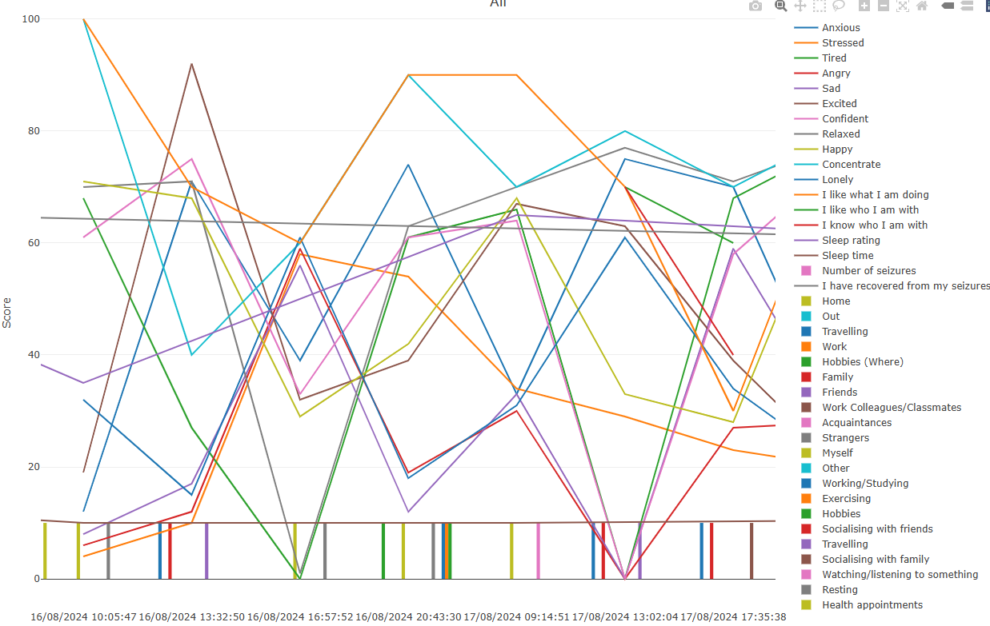
How did you feel last Tuesday?
Notes:
I would get this!
Now this is information we can work with. But there is a downside to this methodology

Slide 7

BURDEN
Notes:
Burden. EMA is a lot of effort for participants or service users.
It can be very off-putting, especially for young adults with rare neurogenetic diseases who are having to manage new responsibilities, along with long term complex physical and mental health needs.

Slide 8
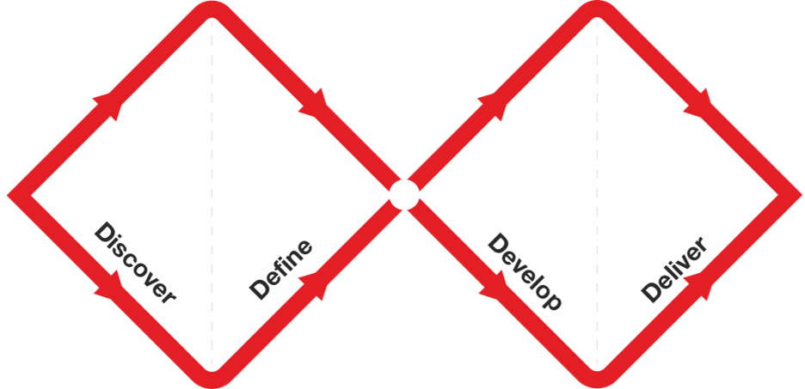
Adapted Methodology – Double Diamond
The Double Diamond is a visual representation of the design and innovation process. It’s a simple way to describe the steps taken in any design and innovation project, irrespective of methods and tools used.
Design Council. The ‘double diamond’design process model. London: Design Council; 2005.
Notes:
Which makes it even more important that we design smart EMA in a way that is acceptable and feasible. As there has been less than 5 studies using smart EMA on individuals with rare neurogenetic diseases. I applied the double-diamond framework to my smart EMA development.

Slide 9
Understanding (not assuming) what is the problem?
Completion rates of smart technology ecological momentary assessment (EMA) in populations at risk of cognitive impairment: A systematic review and meta-analysis.
Notes:
The discover phase
TO me this was all about immersing myself in the literature. What has been done before, what did they learn, what could I improve on.
I did a systematic review and meta-analysis on completion rates in smart EMA in populations similar to my neurogenetic disease

Slide 10

Let the participants explain the challenge
Can I be honest? It's been prepared by a scholar. The idea to have it five times a day? I think...my daughter will get bored and I’m not trying to be rude, I just mean you’ve got to realise how people like her think, how they operate.
Exploring the use of smartphone monitoring for young adults with Tuberous Sclerosis Complex (TSC): A qualitative analysis.
Notes:
The define stage. This is where you let your potential participants immerse themselves in the methodology and see what ideas they come up with for the challenges they might face.
So I ran focus groups with the young adults with the rare disease and their parents. And if there was ever a quote that demonstrates why this stage is so important this is it.

Slide 11
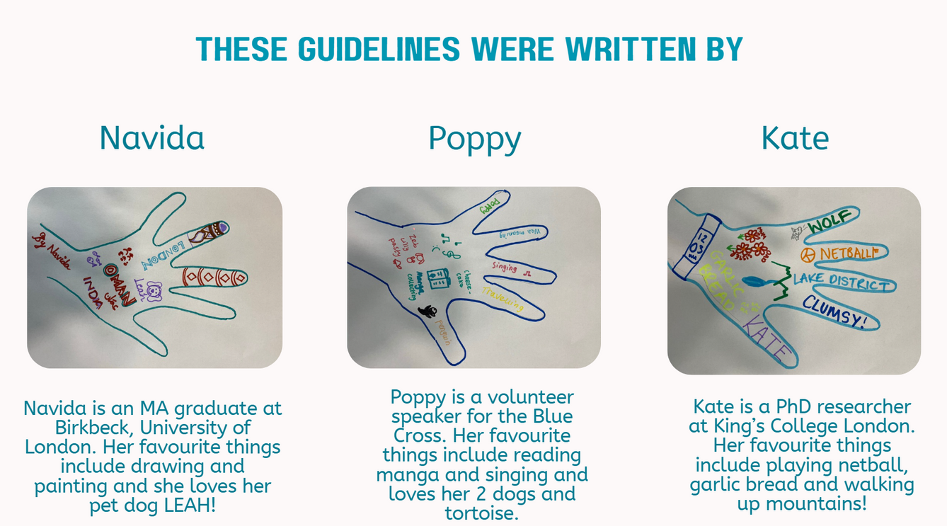
Seeking answers by co-designing
Navida Poppy
How to run a smartphone EMA study for young adults with a rare genetic condition: Co-designed guidelines.
Notes:
The develop stage. To me this was about seeking help to answer the questions from the previous stages. I did this by hiring two young adults with the rare disease to act as advisors throughout my study.

Slide 12
Testing at a small-scale with feedback and documenting experience.
91% Completion rate
When I was explaining my emotions, it made me feel happy. Even when I was sad. I miss the routine of the survey.
Notes:
The Deliver stage. This is about testing the study and gaining feedback
I am currently running a two-week smart EMA protocol, and completion rates are at about 91% so far, demonstrating its feasibility.
This is a post-interview quote demonstrating its acceptability.

Slide 13
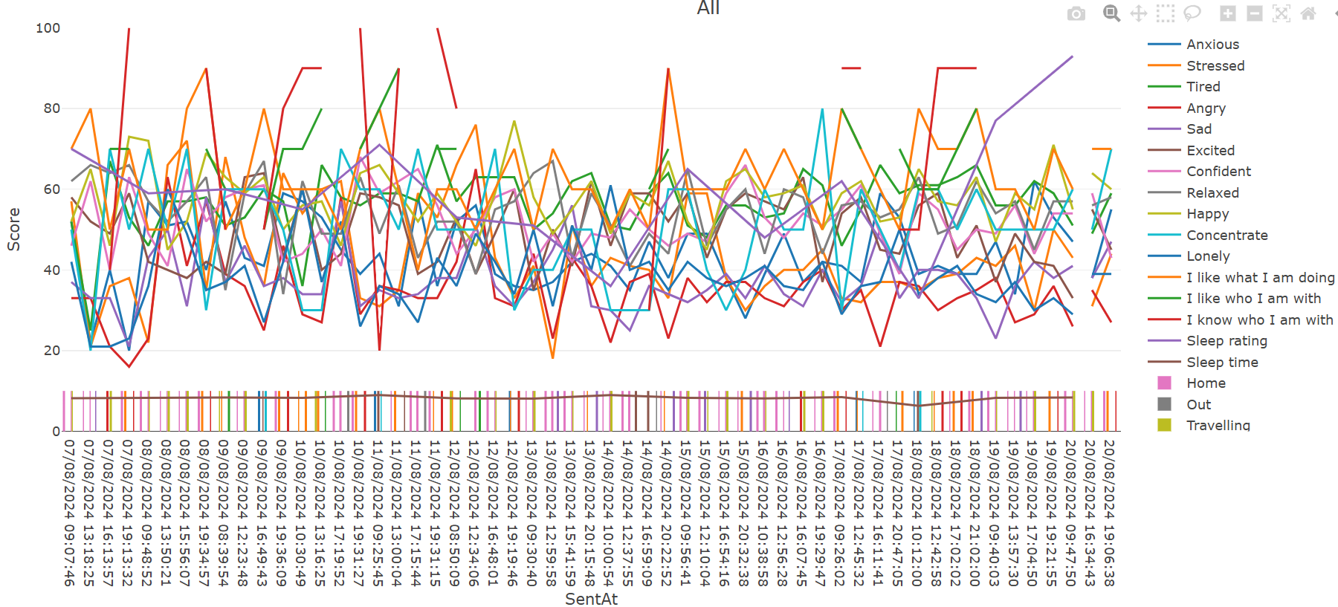
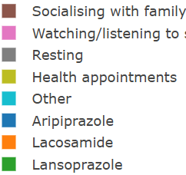
Notes:
So I am confident I can prove smart EMA is feasible and acceptable for young adults with the rare neurogenetic disease who use smartphones. And now, with the use of AI that is able to analyse these large EMA data sets, we will start to better understand their complex everyday experiences leading to personalised support and improved long-term quality of life. Thank you

